Slide 2
Save time and enhance your presentations
100+ predesigned, preapproved slides from our new QuintilesIMS Main slide banks
Access the slide bank directly from here in 3 easy steps and elevate your slides with icons, graphics, agendas, graphs, charts, bios, timelines and more!
  On ribbon, go to Home > New Slide > Reuse Slides – A box will appear
  on the right sidebar
  Paste the link below from Brand World into the “Insert Slide From” field then click the arrow on the right
    IMS employees - https://arc.imshealth.com/gm/document-1.9.9306856/QI_MainSlideBank.pptx
    Q employees - https://quintiles.sharepoint.com/sites/marcom/Shared%20Documents/PPT/MainSlideBank.pptx
  Browse > click on any slide you want to insert, it will upload directly into your deck
  For offline use: please download the slide bank to your computer by right-clicking the link above and saving the slide bank to your desktop
For further guidance, visit the PowerPoint Resource Center on Brand World
  Learn how to use this template and convert your decks into it
  Access images to enhance your presentations

Slide 3
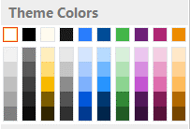
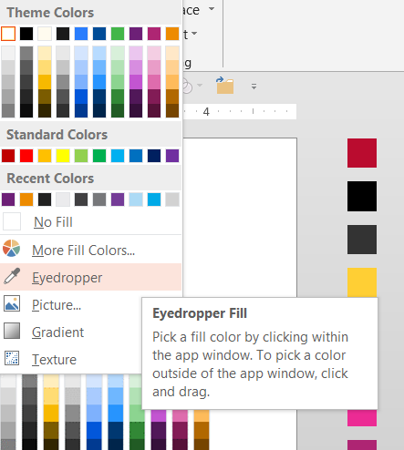
Expanded Color Palette
Six brand theme colors have been built into your PowerPoint
template and should provide you with all of the colors you need.
The optional expanded color palette on the side of every slide
offers you quick access to all of our brand colors. Tastefully
enhance your presentation with our brand colors to accent
graphics, tables, charts, and more.
Choosing your colors
Use your theme colors as your primary colors for your
presentation
If you need more color variety, use the eyedropper tool
Choose a darker tone background color when overlaying
type over a color.
Background colors such as
will provide ample contrast when using a white text.

Slide 4
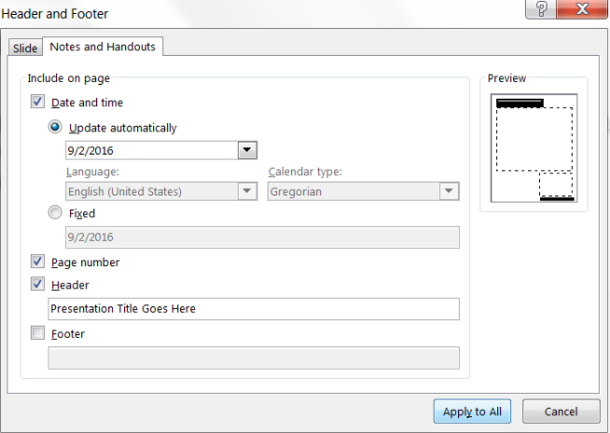
Footers on Slides & Presentation Notes
Footers
The footer section is optional and is to be used for copyrights, sourcing, and any specific notable information regarding the slide or presentation
Presentation Notes
The presentation notes area allows you to add notes for speaking points and can be a printed leave behind
Presentation title on the Notes and Handout pages
Go to the Insert Tab in the PowerPoint ribbon
Click Header & Footer
Choose the Notes and Handouts Tab
Check Header box
Type or copy/paste your presentation
title into the field
Finish by clicking Apply to All

